Slide 1
START
MADE IN YANG
HEIGHT LENGTH LINE
POWERPOINT

Slide 2
THE
PLAYGROUND
OF
TREND
LEADING
SHOPPERS
1.OLVE
NATURAL,HEALTHY 상징, 자연친화적인
내면의 건강함을 통해 외면의 아름다움 지향
2.SYMBOL
OK?
건강한 싱그러움의 상징인 올리브 열매를 형상화
모든 고객이 젋고 건강하게 살아가기를 기원하는 철한
3.YOUNG
ENJOY, ENERRGY, FUN 상징
내면의 건강함을 통해 외면의 젊음 지향

Slide 3
CONTENT TITLE
We provide trendy selection, pleasant shopping
Young lifestyle to our customers
1.OLVE
CONTENT TITLE
We provide trendy selection, pleasant shopping
Young lifestyle to our customers

Slide 4

차별화된 Health&Beauty 상품으로
새로운 쇼핑가치를 창붕하고
고객의 Lifestyle을 선도한다
We provide trendy selection, pleasant shopping
Young lifestyle to our customers
ALL LIVE YOUNG WITH
OLIVE YOUNG
올리브영과 함께 모든 사람이 건강하고
싱그럽게 살아가는 것을 지원하는
올리브영의 철학을 담고 있습니다.

Slide 5
CONTENT TITLE
We provide trendy selection, pleasant shopping
Young lifestyle to our customers
2.SYMBOL
CONTENT TITLE
We provide trendy selection, pleasant shopping
Young lifestyle to our customers

Slide 6

ALL LIVE YOUNG WITH
THE
PLAYGROUND
OF
TREND
LEADING
SHOPPERS
OLIVE YOUNG
올리브영과 함께 모든 사람이 건강하고
싱그럽게 살아가는 것을 지원하는
올리브영의 철학을 담고 있습니다.
2013
2014
2015
2016

Slide 7
ALL LIVE YOUNG WITH
THE
PLAYGROUND
OF
TREND
LEADING
SHOPPERS
OLIVE YOUNG
올리브영과 함께 모든 사람이 건강하고
싱그럽게 살아가는 것을 지원하는
올리브영의 철학을 담고 있습니다.
2013
2014
2015
2016

Slide 8
25%
Twelve kinds of media were
represented at the showlast month
25%
Twelve kinds of media were
represented at the showlast month
25%
25%
PIE
CHART
75%
75%
Twelve kinds of media were
represented at the showlast month
75%
Twelve kinds of media were
represented at the showlast month
75%

Slide 9
CONTENT TITLE
We provide trendy selection, pleasant shopping
Young lifestyle to our customers
3.YOUNG
CONTENT TITLE
We provide trendy selection, pleasant shopping
Young lifestyle to our customers

Slide 10
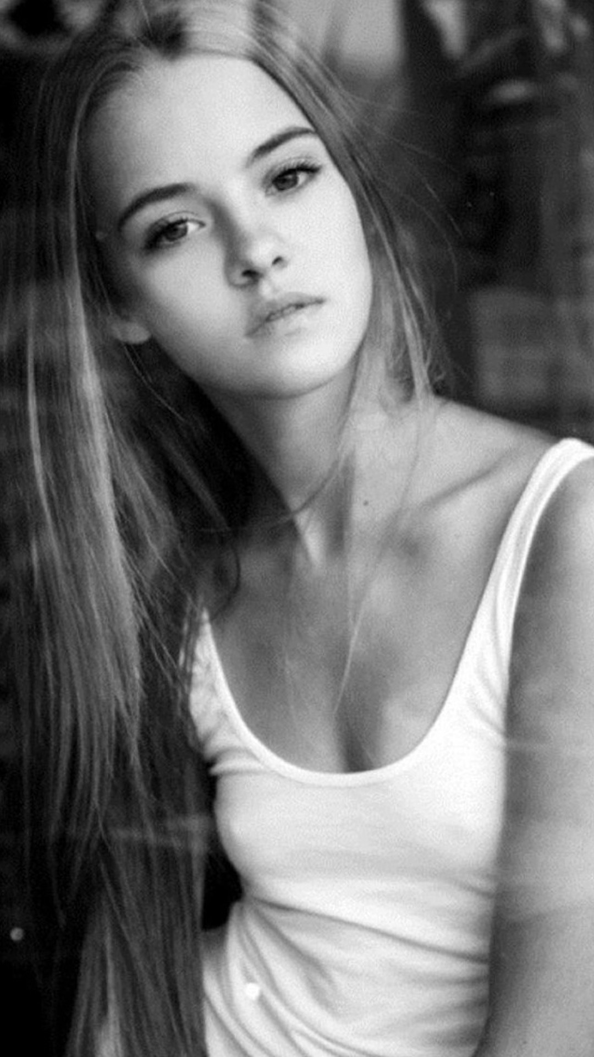
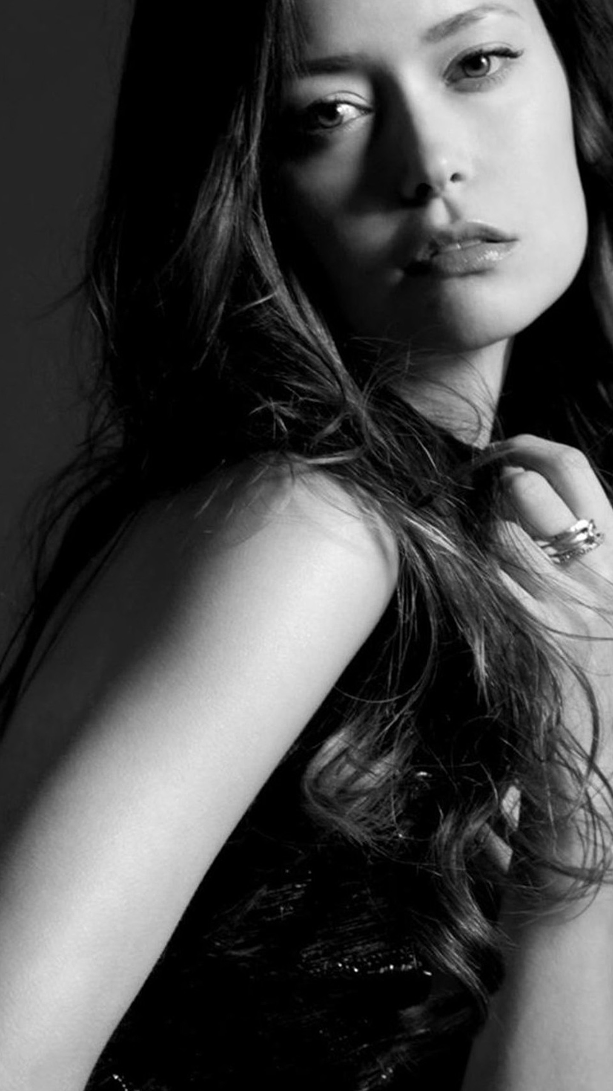
MADE IN
TYPE : 1
OLIVE YOUNG
TYPE : 2
YANG PPT
TYPE : 3
FREE
Twelve kinds of media were represented at the showlast month. It included the work offabic artists, glass artists
leather workers and also
Twelve kinds of media were represented at the showlast month. It included the work offabic artists, glass artists leather workers and also furniture and basket makers.
The admission pro cess for artist is competitive.
TYPE : 1
TYPE : 2
TYPE : 3

Slide 11
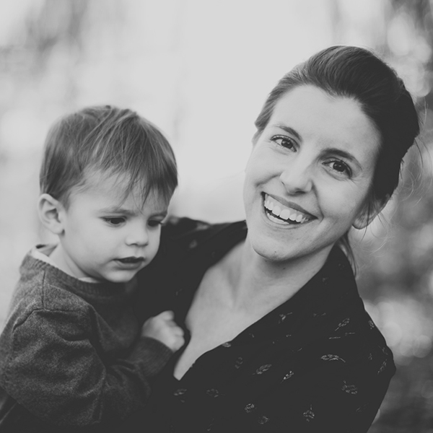
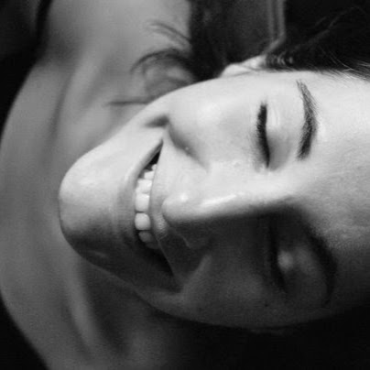

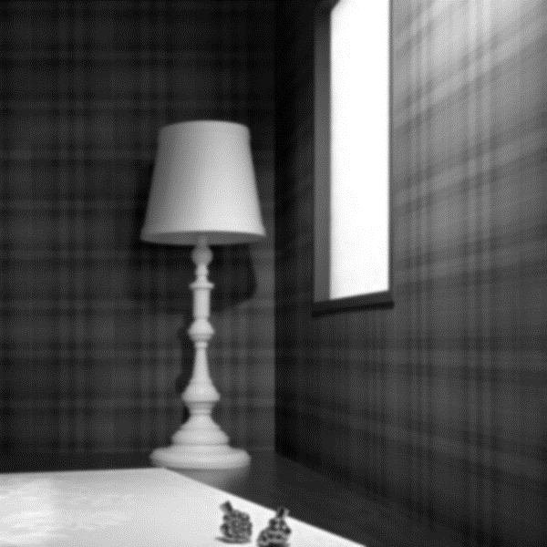
SOURCE : ONE
SOURCE : ONE
SOURCE : ONE
SOURCE : ONE
Twelve kinds of media were
Represented at the showlast month.
It included the work offabic artists,
glass artists leather
Twelve kinds of media were
Represented at the showlast month.
It included the work offabic artists,
glass artists leather
Twelve kinds of media were
Represented at the showlast month.
It included the work offabic artists,
glass artists leather
Twelve kinds of media were
Represented at the showlast month.
It included the work offabic artists,
glass artists leather

Slide 12
AFRICA
SOUTH AMERICA
Twelve kinds of media were represented atthe showlast month. It included the work offabic artists, glass artists leather workers and also furniture and basket makers. The admission pro cess for artist is competitive.
Twelve kinds of media were represented atthe showlast month. It included the work offabic artists, glass artists leather workers and also furniture and basket makers. The admission pro cess for artist is competitive.

Slide 13
THE
PLAYGROUND
OF
TREND
LEADING
SHOPPERS
FINISH

Slide 14
MADE IN
YANG PPT
FREE
Twelve kinds of media were represented at the showlast
month. It included the work offabic artists, glass artists
leather workers and also furniture and basket makers.
The admission pro cess for artist is competitive.
Q&A

